Slide 1

Internet Of Thing
Smart Homes
Name : Swati Vala
ID No. : 25IT445
Sub. : Web Technology

Slide 2
Introduction
IoT
The Internet of Things (IoT) refers to a network of interconnected physical objects such as devices, machines, vehicles, or people embedded with sensors, software, and unique identifiers that enable them to collect, exchange, and process data over a network without requiring direct human-to-human or human-to-computer interaction.
Definition Of Smart Homes
A smart home is a house where devices and appliances can be controlled automatically or from far away using the internet. People can control them using a mobile phone or other smart devices.
What Is a Smart Home?
A smart home has devices that are connected to the internet. These devices help control things like security, lights, temperature, and appliances. You can manage them anytime and from anywhere using a smartphone. Smart home systems can work with wired or wireless connections.
Core Idea :
Smart homes use IoT technology to automate and control household devices, enhancing comfort, security, energy efficiency, and convenience for a better living experience.
              By ADAM HAYES

Slide 3
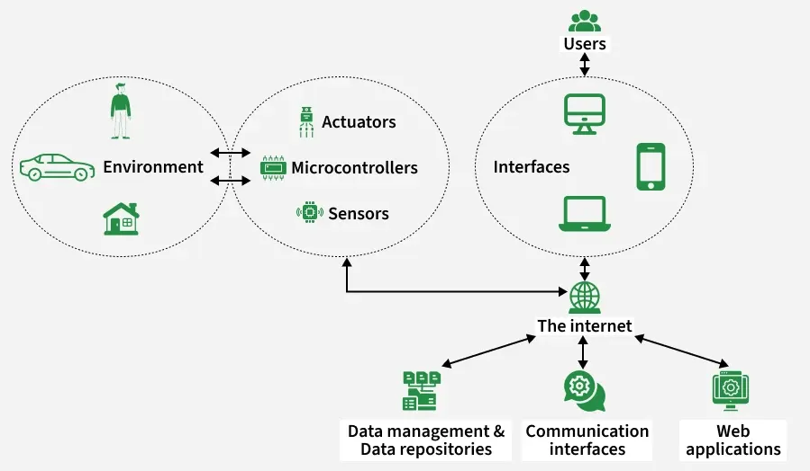
Key Components of Smart Home System
Environment
The environment includes everything around the smart home, such as people, vehicles, rooms, lights, temperature, and doors. Changes in the environment are detected by sensors, and actions are taken to control it.
SensorsSensors
Collect information from the environment. They detect things like motion, temperature, light, smoke, or gas. This data is sent to the microcontroller for processing.
Microcontrollers
Microcontrollers act as the brain of the system. They receive data from sensors, make decisions, and send commands to actuators. Examples include Arduino or ESP boards.

Slide 4
4. Actuators
Actuators perform actions based on commands from the microcontroller. They control devices such as lights, fans, doors, motors, and alarms by turning them ON or OFF or adjusting their movement.
5. Interfaces
Interfaces allow users to interact with the smart home. These include mobile phones, computers, tablets, and displays. Users can monitor and control devices through apps or dashboards.
6. Users
Users are the people who use and control the smart home system. They send commands and receive updates using interfaces like smartphones or computers.
7. Internet
The internet connects all smart home devices and allows remote control and monitoring. It helps devices communicate with users and online services from anywhere.
8. Data Management & Data Repositories
These store data collected from sensors, such as temperature history or security logs. Stored data helps in analysis, automation, and decision-making.
9. Communication Interfaces
These manage how data is transferred between devices, servers, and users. They ensure smooth and secure communication within the system.
10. Web Applications
Web applications allow users to access and control the smart home through a web browser. They provide dashboards, settings, and real-time status updates.
By easybom

Slide 5
Core Application Areas
There are many uses of IoT in smart homes that help people all over the world. Some common examples are:
1. Smart Lighting
Lights turn on or off automatically when someone enters or leaves a room, or depending on sunlight.
They can be controlled by time schedules or voice commands.
This helps save electricity and makes the home look better.
2. Smart Thermostats
These devices change the room temperature automatically based on weather and usage.
They help reduce electricity and gas bills.
You can control them from anywhere using a phone.
3. Home Security Systems
These include door and window sensors, smart locks, alarms, and cameras.
You can lock or unlock doors and watch your home remotely.
They send alerts if there is any suspicious activity.
4. Smart Kitchen and Appliances
Appliances like ovens, refrigerators, and dishwashers become smart.
They inform you when food is ready or when items are running out.
They can also connect with recipes and calendars.

Slide 6
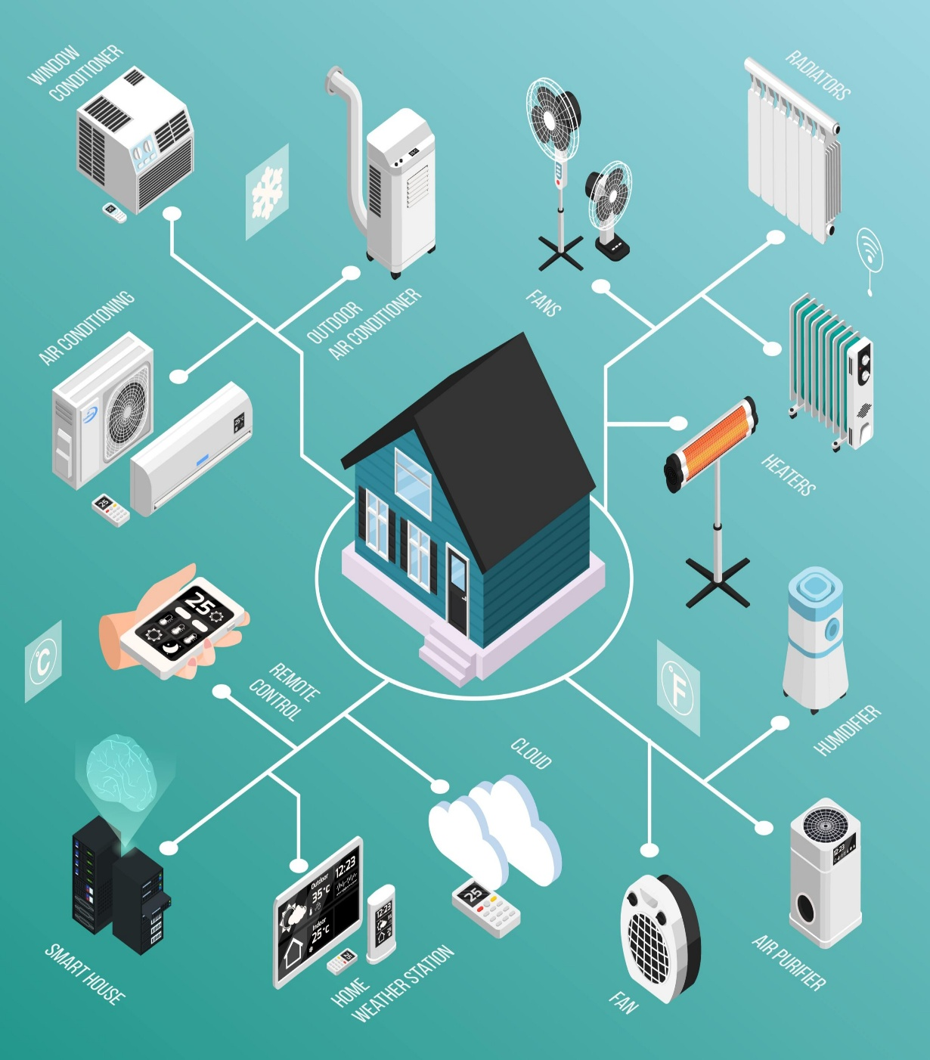
5. Smart Entertainment Systems
You can control TVs, speakers, and
gaming systems from one place.
They allow automatic streaming,
custom music lists, and voice control.
6. Health and Wellness Monitoring
Devices track sleep, air quality,
and noise levels.
They are very helpful for elderly
people and those with special
needs.

Slide 7
How it Works : A Scenario
All smart home devices are connected to each other.
They can be controlled from one central device like a mobile phone, tablet, laptop,
game console.
Devices such as door locks, TVs, thermostats, cameras, lights, and refrigerators
Can be managed using one home automation system.
A remote control system allows users to:
Schedule tasks
Turn devices on or off
Check device status from anywhere.
Smart home devices can learn the user’s daily routine.
They automatically adjust lighting and temperature based on usage.
This helps save energy and reduce electricity bills.
Some smart home systems send alerts when motion is detected while the user is away.
Other systems can contact the police or fire department in case of danger.
Smart devices like doorbells, security systems, and appliances are part of IoT.
IoT connects physical devices that collect and share information through the internet.

Slide 8
Home Automation Technology
Home automation means using smart technology to control and manage home devices automatically. It helps make daily life easier, more comfortable, and more energy-efficient. With home automation, people can control lights, thermostats, security cameras, and kitchen appliances from anywhere using a smartphone or by giving voice commands.
These systems allow users to set schedules, monitor their homes remotely, and automatically respond to changes like temperature or lighting conditions. This creates a smooth and easy way to use technology in everyday life.
In recent years, wireless technologies such as Wi-Fi and Bluetooth have become very common in homes. In home automation, wireless systems offer many benefits compared to wired networks, such as easy installation, flexibility, and better connectivity.
        By GeeksforGeeks

Slide 9
Architecture Overview
Smart Home and IoT System
Devices connected through a local network
Uses Wi-Fi, Bluetooth, ZigBee, or other wireless technologies
Sensors and appliances share data
Server controls devices and stores data
Cloud used for remote processing and control
Users can monitor and control devices remotely
Supports automatic operation and management
Five-Layer Smart Home Architecture
Resource Layer – sensors and smart appliances
Interface Layer – device communication
Agent Layer – data processing and coordination
Kernel Layer – system control and management
User Application Layer – mobile apps, web apps, APIs

Slide 10
Cloud Service Models
Infrastruc-ture as a Service (IaaS)
Platform as a Service (PaaS)
Software as a Service (SaaS)
Three-Layer Architecture
Sensing and Actuatig Layer
Network Layer
Applicai-on Layer
Smart Home Services
Security
Healthcare
Video monitoring
Energy management
Entertainment

Slide 11
Benefits of Smart Homes
Smart homes provide many useful benefits that make daily life easier and more comfortable.
They offer convenience and automation, where everyday tasks like changing room temperature or closing doors can happen automatically and can be controlled from anywhere.
They help with saving energy. Smart lights and thermostats reduce wasted electricity, which lowers electricity bills and is better for the environment.
They improve home security. Features like motion sensors and live camera monitoring help homeowners feel safer and more relaxed.
They also improve accessibility. For elderly people or those with disabilities, smart homes make daily tasks easier using voice commands and customized settings.

Slide 12
Risks and Challenges
Even though smart homes have many advantages, they also have some problems that homeowners need to think about.
There are privacy and security risks. Since devices are connected to the internet, they can be hacked, and personal data may be stolen.
There is also too much dependence on technology. Relying heavily on smart systems can reduce family interaction and basic problem-solving skills.
Cost is another issue. Buying and setting up smart devices can be expensive, which may not be affordable for low-income families.
Lastly, there are compatibility problems. Devices from different companies may not work well together, which can make using the system confusing and frustrating.

Slide 13
Trends Shaping the Future
New trends show how smart homes will keep improving in the future.
AI assistants are becoming more common. Smart homes can understand user habits and even predict needs using artificial intelligence.
Eco-friendly and sustainable design is gaining importance. Devices that track air quality, energy use, and water consumption help protect the environment.
5G and edge computing will make smart homes faster and more reliable by improving internet speed and device performance.
Finally, better privacy control is being developed. Homeowners want more control over their data, using secure systems and storing data locally instead of online.

Slide 14
Conclusion
Smart homes are more than just new technology. They are changing how we live and how we use our personal space. While they offer comfort, safety, and help the environment, it is important to protect privacy and ensure fair access for everyone.
The main goal should be to create homes that improve our lives without harming our values. For developers, policymakers, and users, the future of smart homes needs careful design and strong ethical responsibility.
By Chiara Veri

Slide 15

!

